Slide 1


Seizure Detection Using Wearable Devices
Submitted in the partial fulfillment for the award of the degree of
BACHELOR OF ENGINEERING
IN
Artificial Intelligence and Machine Learning
Submitted by:
Dipin Raj : 21BCS6729
Jeevan A J : 21BCS6589
Akshay S : 21BCS5849
Rhishitha T S : 21BCS6272
Rashaz Rafeeque : 21BCS6634
Under the Supervision of:
Ms. MERRY K P
Assistant Professor
AIT-CSE AIML Department
Chandigarh University
Department of AIT-CSE
DISCOVER . LEARN . EMPOWER

Slide 2
SEIZURE DETECTION USING
WEARABLE DEVICES
PRESENTED BY
DIPIN RAJ
JEEVAN A J
AKSHAY S
RHISHITHA T S
RASHAZ RAFEEQUE

Slide 3
INTRODUCTION
Epileptic seizure affects approximately 50 million people worldwide. One of the greatest challenges in epileptic seizure is detecting a seizure and responding accordingly to avoid injuries and save lives.
Therefore, seizure detection and prediction play a vital role in seizure treatment. But traditional methods such as using an EEG or video EEG to detect seizure are often expensive and not viable for everyday use.
Hence developing a wearable device using machine learning model could be a paradigm-shifting technology in the field of epilepsy.

Slide 4
PROBLEM FORMULATION
The problem is to develop a machine learning model that can accurately detect seizures in people with epilepsy using sensor data obtained from wearable devices.
The system should be capable of collecting and storing physiological signals like EDA and ACC, which can help identify the occurrence of seizures.
The model should be designed to provide real-time alerts when a seizure is detected, enabling timely intervention by caregivers or medical professionals.
By providing a reliable and accurate seizure detection system, this technology can reduce the burden on caregivers and healthcare providers while providing greater independence and freedom for individuals with epilepsy.

Slide 5
PROJECT OBJECTIVES
TRAINING MODEL
DEPLOYING MODEL
FINDING ACCURACY
To train a machine learning model and analyse the data from various multimodal sensors.
To provide a reliable and accurate seizure detection machine learning model.
To find the accuracy of the model produced by the multimodal sensors.

Slide 6
PROJECT TIMELINE
STAGE 02
STAGE 04
STAGE 01
STAGE 03
LITERATURE REVIEW
DRAFTING
Drafting the manuscript including abstract introduction conclusion and subtopics
Conducting a literature review for the background information
DATA COLLECTION
SUBMISSION
Submitting the drafted manuscript to a suitable journal.
Collecting the required data and cleansing it for the research work

Slide 7
METHODOLOGY USED
01
02
03
04
EXTRACTION
PREPROCESSING
Dataset consisting of values from EDA(ElectroDermal Activity) and ACC(Accelerometer) sensors are acquired.
The dataset undergoes preprocessing and necessary features are selected.
ALGORITHMS
EVALUATION
Machine learning classification algorithms such as KNN, SVM, Naive Bayes, and Logistic Regression will be applied on the dataset.
The results of these techniques will be compared and reviewed based on metric scores such as Accuracy, Precision,etc .

Slide 8
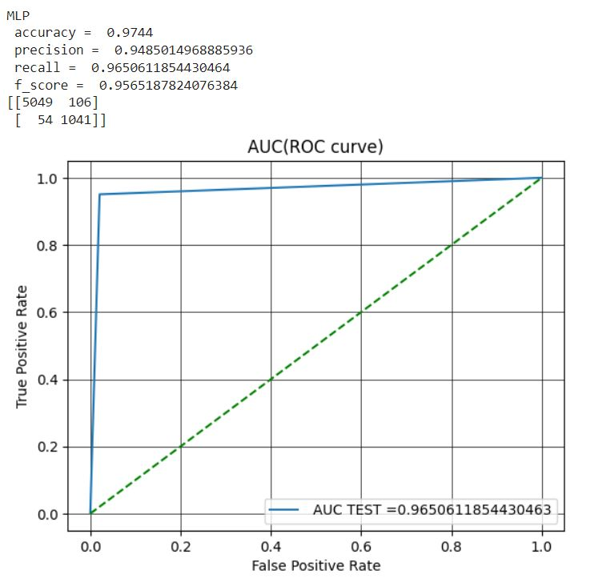
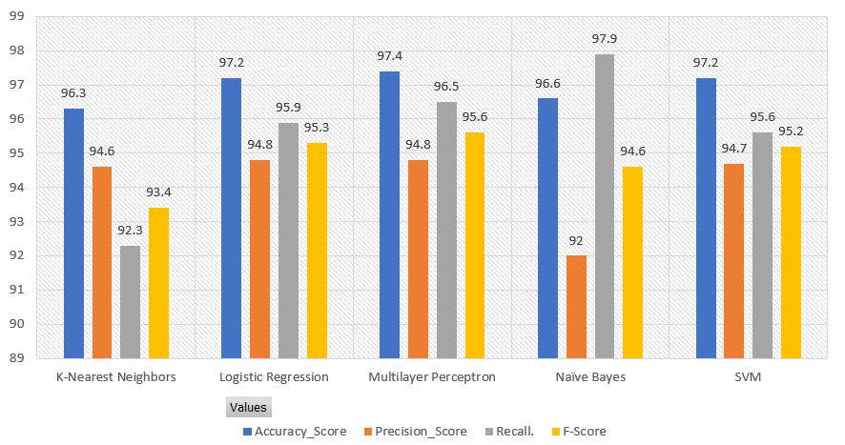
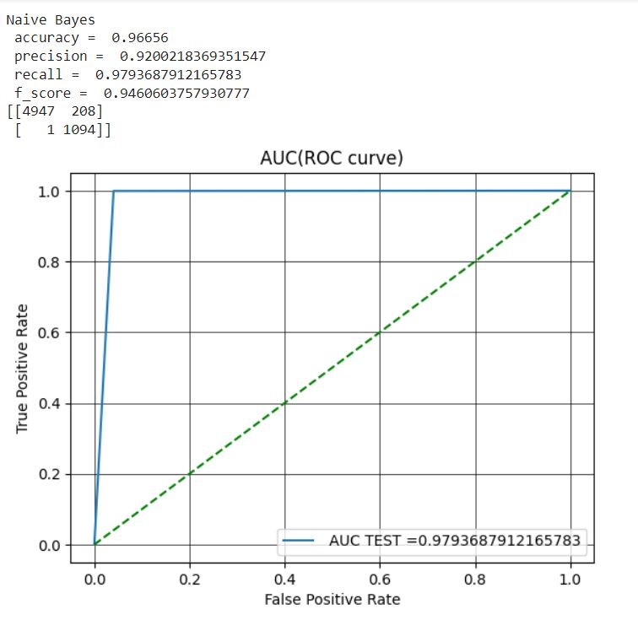
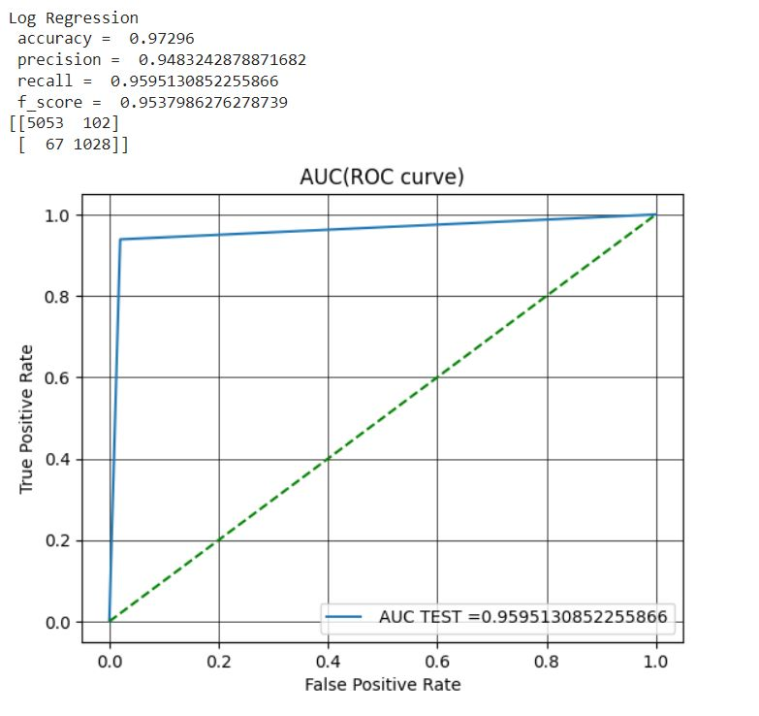
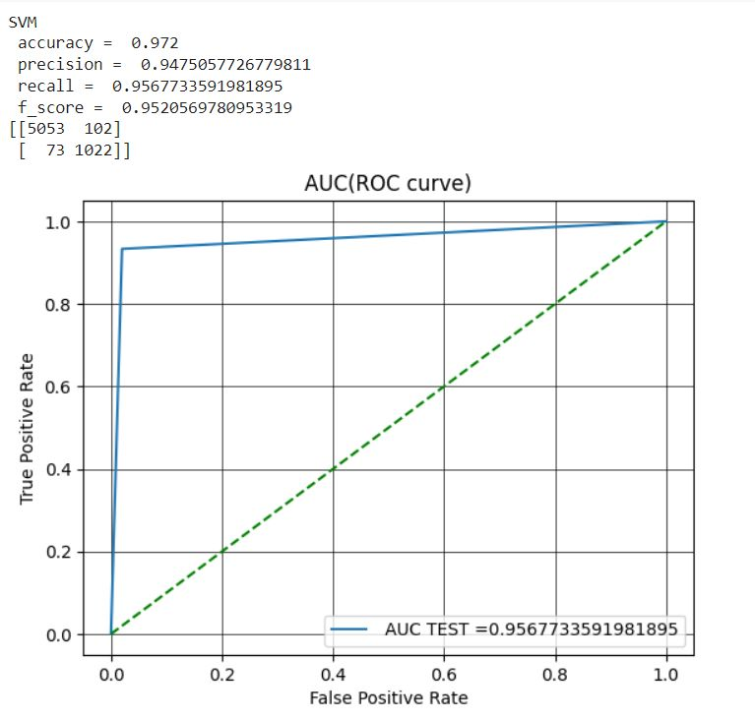
RESULTS
In the study of the multimodal datasets, among all the classifiers tested it is evident that the MLP classifier transcended in performance, as evidenced by its accuracy of 97.4%, precision of 94.8%, recall of 96.8%, and F-score of 95.6%.
The Logistic Regression approach has good accuracy, precision, recall, and F-score, measuring 97.2%, 94.8%, 95.9%, and 95.3%, respectively.
The Support Vector Machine Algorithm F-score was 95.2% because it had the best accuracy (97.2%), Recall of 95.6%, but a lesser precision (94.7%).
The K-Nearest Neighbours and Naive Bayes methods performed the worst overall, with accuracy ratings of 96.3% and 96.6%, respectively.
These findings imply that the MLP classifier performs better than other classifiers evaluated in this work and is capable of handling multimodal datasets.

Slide 9
CONCLUSION AND FUTURE SCOPE
The combination strategy works well, as seen by the high accuracy of 97.4% in seizure detection.
Correct identification permits quick action and appropriate management, lowering the risks and outcomes related to seizures.
It is essential to be able to distinguish between various seizure types since it enables customised management and treatment strategies.
Wearable technology provides a non-intrusive and simple solution, enabling users to monitor their health and carers to get timely notifications.
Sensor accuracy and reliability: Further research and development are needed to improve the accuracy and reliability of biosensors to minimize false positives or negatives.
Integration with healthcare systems: Seamless integration of wearable devices with existing healthcare systems is crucial for effective seizure detection and management.

Slide 10
Together let's make the change!

Slide 11
THANKS!

